Slide 1
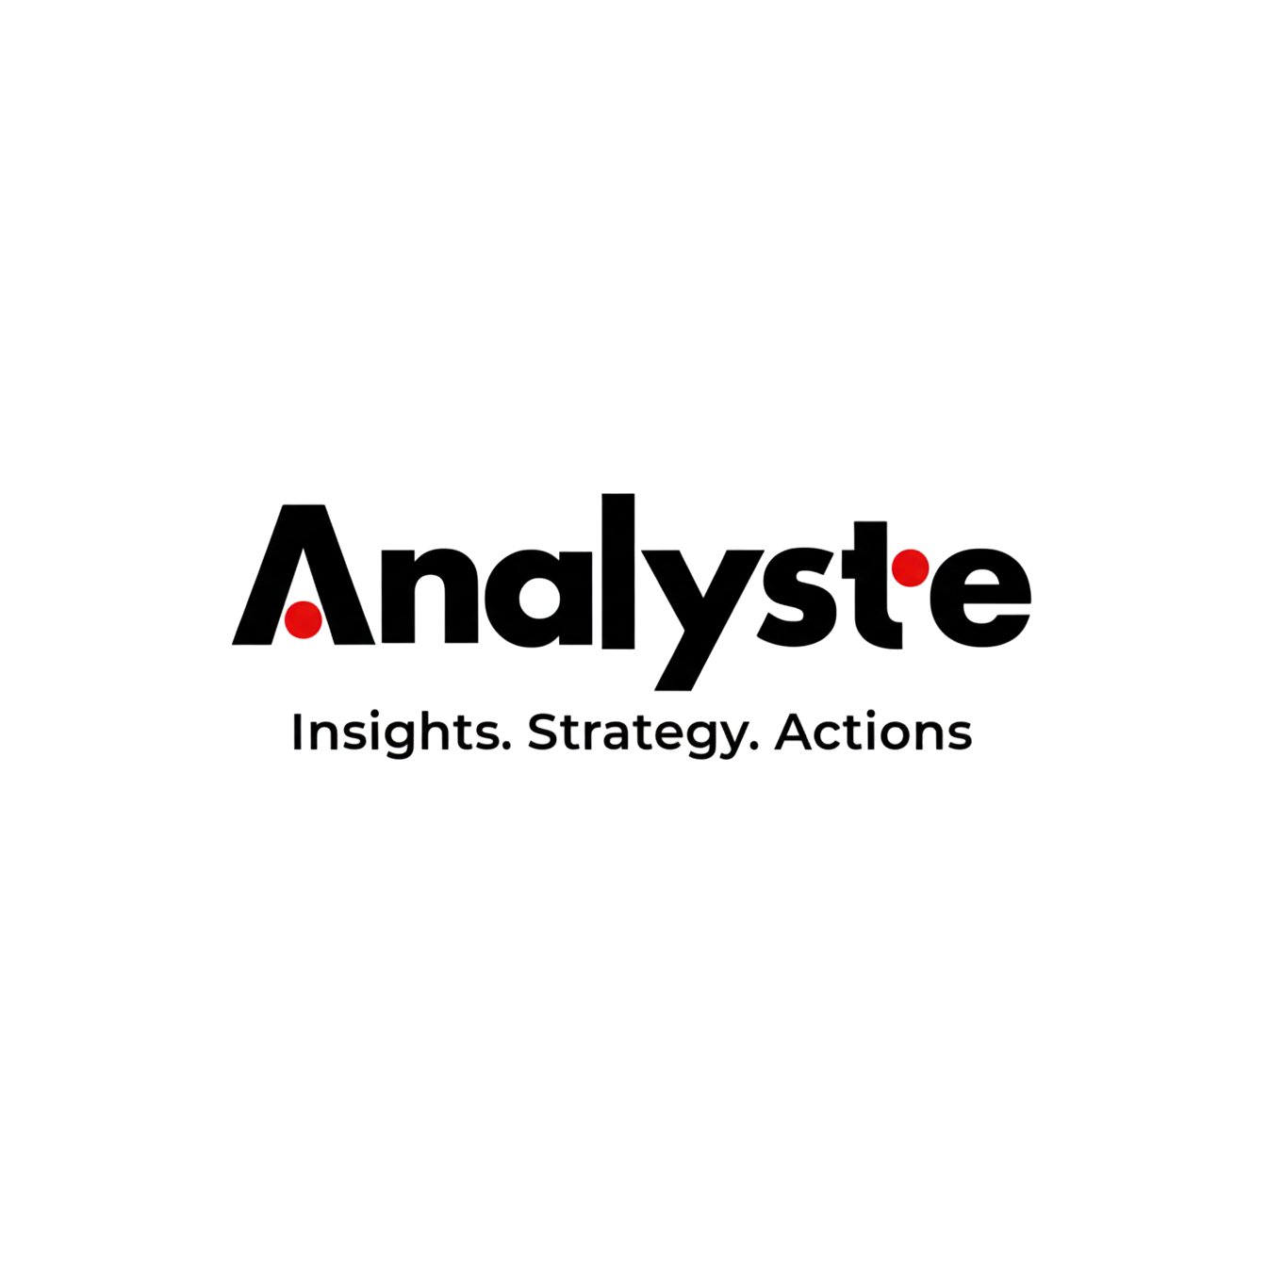
Corporate Profile

Slide 2
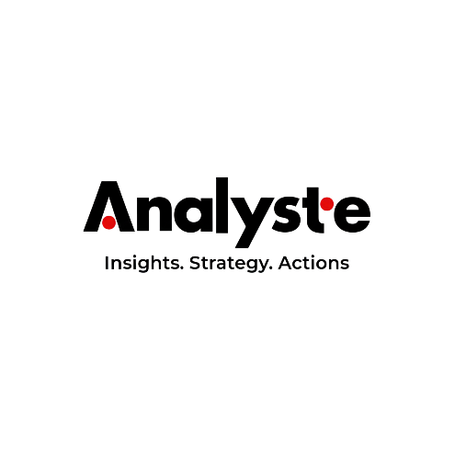
Message from the Founder
At Analyste, we believe that every great success starts with Analysis.
In today’s fast-paced and ever-changing business environment, companies need more than just ideas—they need insights, strategies, and actions. That’s why we created Analyste: to empower businesses, especially startups, SMEs, and ambitious brands, with the tools and expertise they need to grow, adapt, and lead.
We bring together two critical forces—financial intelligence and Strategic Thinking—under one roof, delivering a 360° approach to business consultation. Our role isn’t just to advise; it’s to partner, co-create, and unlock potential. Whether you need to build a solid financial framework or enhance performance or develop a sustainable growth plan - we’re here to support your journey.
Analyste was born with a regional mindset and a global ambition. we are ready to scale with our clients—wherever their vision takes them.
Welcome to Analyste—where strategy meets execution, and insights become impact.

Slide 3
Our Story
Every business has a vision—a goal to grow, expand, and thrive. But in today’s fast-moving world, financial complexity often stand in the way. That’s where Analyste steps in.
Founded on the belief that clarity drives success, Analyste is more than a consulting firm; we are partners in precision and performance. We don’t just analyze numbers—we uncover opportunities. We don’t just build strategies—we execute them.
Our expertise lies at the intersection of financial intelligence and strategic decision-making, helping SMEs and startups make informed, strategic decisions. Whether it's financial forecasting, pricing strategies, or building a solid financial framework, we bring data-driven insights and real-world execution to the table.
At Analyste, we believe in:
✔ Precision – because the right numbers lead to the right decisions.
✔ Strategy – because growth isn’t accidental, it’s planned.
✔ Execution – because ideas alone don’t drive success—actions do.
We simplify the complex. We transform insights into measurable impact. We help businesses move from uncertainty to confidence.
Analyste: Because every Success start with Analysis.

Slide 4


Why we Exist ?
Vision
To transform the financial landscape for SMEs and large enterprises across Egypt and the GCC, creating a future where every business achieves global competitiveness through innovation, empowerment, and sustainable growth.
Mission
Our mission is to provide world-class financial and data insights consultation and training services to SMEs and large enterprises in Egypt and the GCC. By leveraging advanced technology, data-driven strategies, and a deep understanding of market dynamics, we deliver tailored solutions that drive growth, enhance efficiency, and foster innovation.
Our team of highly experienced and educated professionals is dedicated to excellence, integrity, and building long-term partnerships. We aim to be the trusted partner for businesses seeking to navigate complex challenges, capture opportunities, and achieve their full potential.
Our philosophy is rooted in empowering businesses with the knowledge, tools, and strategies they need to thrive in a dynamic global economy..

Slide 5
Core Values
Accountability We hold ourselves accountable for delivering results and maintaining the highest standards of professionalism.
Novation (Innovation) We continuously innovate to provide cutting-edge solutions that keep our clients ahead of the curve.
Leadership
We lead by example, setting industry benchmarks and inspiring our clients to achieve greatness.
Adaptability We remain agile and responsive to the unique needs of both SMEs and large enterprises in a dynamic market.
Yield (Results-Oriented)
We are committed to delivering measurable, impactful outcomes that drive growth and success.
Sustainability
We focus on creating long-term value, ensuring our clients' resilience and adaptability in a competitive world.
Trust
We build trust through transparency, honesty, and reliability in every interaction.
Empowerment We empower businesses of all sizes with the tools, knowledge, and confidence to take control of their future.

Slide 6
Our Services

Slide 7
Financial Planning & Analysis (FP&A)
We help businesses anticipate the future and prepare for it with confidence. Our FP&A services are structured to provide financial clarity, align business goals with financial realities, and support strategic decision-making.
Budgeting & Forecasting We develop detailed, bottom-up or top-down budgets and forecasts that incorporate operational inputs, historical trends, and market conditions. Our approach ensures financial targets are realistic, data-driven, and aligned with business strategy.
Cash Flow Projections We model short-, medium-, and long-term cash flows to help you plan for liquidity needs, funding gaps, and investment opportunities. Our cash flow tools are practical and easy for internal teams to maintain.
Scenario & Sensitivity Analysis Understand how changes in variables—like sales volume, pricing, or costs—impact your bottom line. We build flexible models that allow you to simulate different outcomes and prepare contingency plans for any business condition.
Strategic Business Planning Support We partner with your executive team to translate strategic goals into financial language. Whether launching a new product, entering a new market, or restructuring operations, we ensure your financial plan supports your business vision.

Slide 8
Management Reporting
We transform raw data into insightful reporting that supports quick, confident decisions. Our management reports are designed to meet the needs of CEOs, CFOs, and operational leaders alike.
Design of Dashboards (Power BI / Excel) We build interactive dashboards that consolidate key financial and operational metrics. Whether using Power BI or Excel, our designs are intuitive, visually clear, and tailored to each department's needs.
Monthly & Quarterly Management Reports We prepare structured management reports with financial statements (P&L, balance sheet, cash flow), variance commentary, trend graphs, and actionable summaries. These reports are tailored for internal use or board meetings and include benchmarking if needed.
KPIs & Performance Metrics We help define and track the metrics that matter most—such as revenue per employee, gross margin, store-level profit, inventory turnover, and more. We ensure every number you monitor links back to your strategic priorities.
Variance Analysis (Budget vs. Actual) Our reports identify why results deviated from expectations, whether due to pricing, volume, costs, or timing. We don’t just highlight the gaps—we explain them with context and root causes.

Slide 9
Costing & Profitability Analysis
Many businesses operate without knowing the real cost of their products or services. We help you uncover your actual cost drivers and maximize profitability through actionable insights.
Cost Structure Optimization We assess all categories of expenses—direct, indirect, fixed, and variable—to identify non-essential costs, duplication, and inefficiencies. We then propose restructuring scenarios and cost-saving measures that maintain operational performance while improving financial results.
Product/Service Costing Models We build costing models that consider direct and indirect costs, labor, materials, and overhead. You’ll understand exactly how much each unit, product line, or service is costing you—and how to price accordingly.
Break-Even & Margin Analysis We calculate break-even points by business unit, store, or product and analyze contribution and gross margins to determine where you are making or losing money. This helps identify underperforming products or regions and fine-tune your sales strategy.
Profit Center & Profitability We design a profitability framework that attributes income and expenses to each cost or profit center, such as a retail store, sales region, or product category. This enables you to compare performance and make informed decisions on expansion, closure, or resource allocation.

Slide 10
Accounting Review & Gap Analysis
Reliable accounting is the foundation of strong decision-making. We provide a comprehensive review of your accounting cycle, identify process weaknesses, and recommend corrective actions.
End-to-End Accounting Cycle Review We evaluate every stage of your accounting—from transaction recording and reconciliations to month-end closing and reporting. We highlight inefficiencies, errors, or risks and help redesign workflows.
Chart of Accounts Structuring A poorly designed chart of accounts leads to confusing and inaccurate reports. We restructure it for clarity, control, and alignment with business units, cost centers, and reporting needs.
Internal Controls Assessment We assess your financial controls related to cash handling, approvals, asset tracking, and system access. Our recommendations reduce the risk of errors, fraud, and audit issues.
ERP Setup Advisory (SAP, Oracle, Odoo, etc.) Whether you're implementing or optimizing ERP systems, we support you in configuring modules to support clear and consistent financial reporting and workflows.

Slide 11
Cash Flow & Working Capital Management
A profitable business can still fail if it runs out of cash. We help you maintain liquidity, improve working capital, and avoid funding crises.
Liquidity Forecasting We prepare daily, weekly, or monthly cash flow forecasts that consider all expected inflows and outflows, enabling you to avoid overdrafts, missed payments, or funding surprises. We also build models to support loan planning or capital investment decisions.
Cash Conversion Cycle Analysis We analyze how long it takes to convert investments in inventory and receivables into cash. Then we recommend ways to shorten the cycle and free up capital.
Payables/Receivables Optimization We review payment terms, collection policies, and invoice aging to suggest changes that improve cash inflows and balance supplier relationships. We often recommend setting credit limits, improving invoicing speed, or incentivizing early payments.
Treasury & Banking Advisory We help you manage bank relationships, evaluate financing options, and optimize your use of credit lines and banking products.

Slide 12
Business Intelligence & Data Analytics
Data should guide your decisions, not confuse you. We connect your systems, clean your data, and build powerful visuals to help you manage smarter.
Power BI Dashboard Development We design visual, real-time dashboards that summarize your financial and operational performance. They’re tailored to your business and accessible across devices.
Data Cleaning & Financial Modeling We structure and prepare your data for analysis, removing inconsistencies, duplicates, and errors. Then we build accurate, flexible financial models for planning and forecasting.
Integration of ERP Data into BI Systems We connect your ERP or accounting system to BI tools, ensuring your dashboards automatically update and reflect the latest business data.

Slide 13
Feasibility Studies
Before you invest time, capital, or resources into a new project, we help you understand its financial, market, and operational viability.
Market & Industry Analysis We assess current market conditions, demand trends, competition, customer behavior, and pricing strategies. This helps you understand the potential for growth and success in a specific sector or region.
Financial Projections & ROI Modeling We develop detailed financial models covering revenue assumptions, capital expenditure, fixed and variable operating costs, cash flows, breakeven analysis, and return on investment. Our models are decision-ready and customizable.
Operational Feasibility We evaluate supply chain needs, logistics, manpower, technology, and infrastructure to determine whether the project can be executed effectively within your timeline and resources.
Risk & Scenario Assessment We identify risks (financial, market, regulatory) and model best-case, base-case, and worst-case outcomes. This enables you to prepare contingency plans and understand downside exposure.
Investor & Lender-Ready Reports Our feasibility study documents are professionally structured with clear financials, assumptions, SWOT analysis, and executive summaries—ready to be submitted to investors, banks, or internal stakeholders.

Slide 14
Meet Our Founder

Slide 15

Mohamed Mostafa
Mohamed is a seasoned finance leader with over 15 years of experience in financial planning and analysis, business intelligence, and strategic budgeting across leading sectors such as FMCG, retail, logistics, manufacturing, and real estate. He is the visionary behind Analyste, a firm dedicated to transforming financial data into actionable insights for businesses of all sizes.
A certified CMA, FMVA, and CFC, Mohamed is pursuing an MBA in Strategic Management. He combines technical expertise in Power BI, SAP, and financial modeling with strong business insight to build smart, automated reporting systems that drive better decisions.
As a consultant, Mohamed has delivered high-impact FP&A projects and financial feasibility studies for clients across industries, including:
Rizkalla Group – Home appliances
Prego – F&B retail
Free Air – Air conditioning manufacturing
Fastrak – Logistics & warehousing
Ebny – Real estate development
Al Ahly Sporting Club – Sports & community services
Mohamed’s mission with Analyste is to empower SMEs and startups with the same level of financial clarity and strategic foresight that powers large corporations—bridging the gap between data and direction.

Slide 16


















Past Experience

Slide 17






Our Clients
Egypt
S.A.E

Slide 18
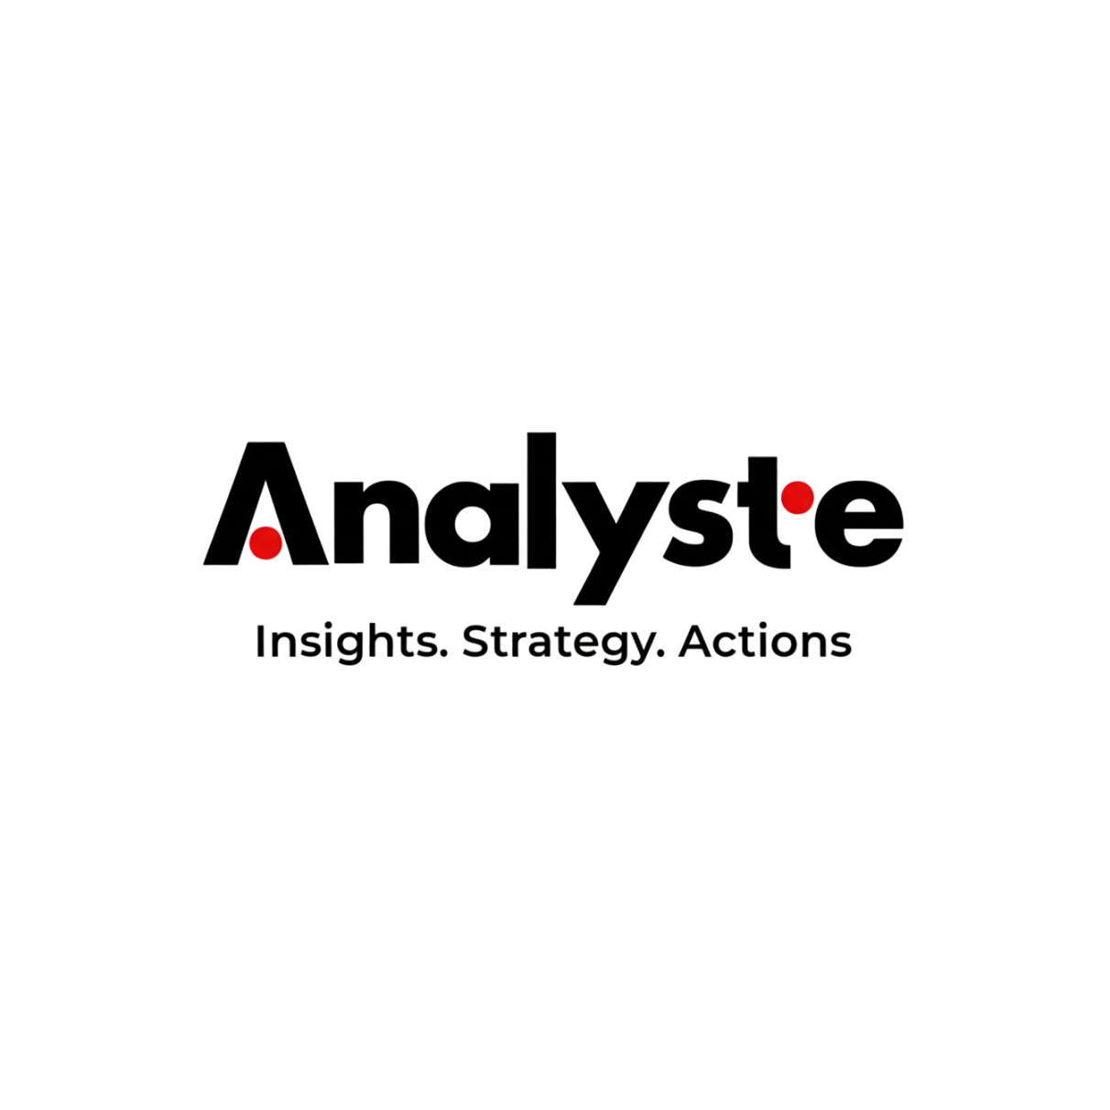
We’re here to support your next move. Let’s talk.
Mobile: +20 1000424081
Office Address: Building Lotus 2, North 90 St. , behind Chillout, New Cairo, Egypt
Email: info@analyste.co
Website: www.analyste.co

